Slide 1

Matching Text with Regular Expressions
Michigan Python
@danyeaw

Slide 2
Regular Expression
A sequence of patterns that specifies a match pattern in text.
Also known as Regex and RE

Slide 3
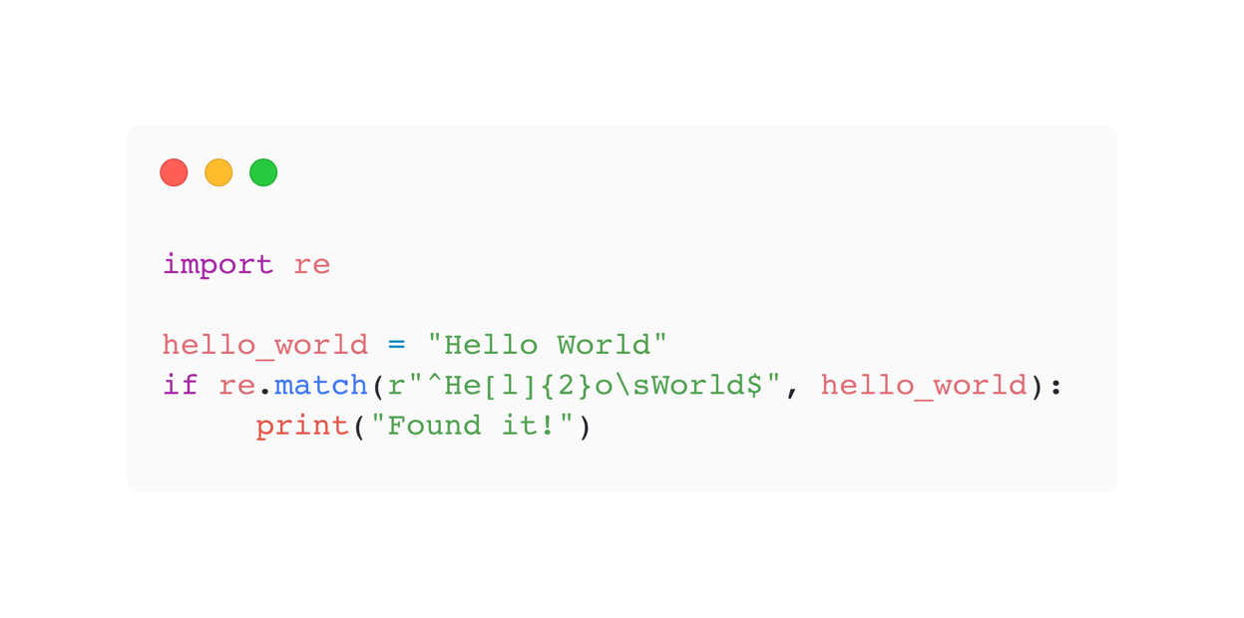
Hello World

Slide 4
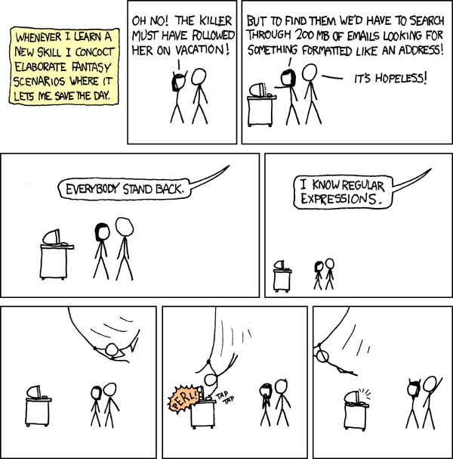
https://xkcd.com/208/

Slide 5
“
Some people, when confronted with a problem, think "I know, I'll use regular expressions." Now they have two problems.
Jamie “jwz” Zawinski
”

Slide 6

The Hot Sauce of Programming
Expensive
Greedy
Opaque
CC BY-SA 3.0 by Skb8721

Slide 7
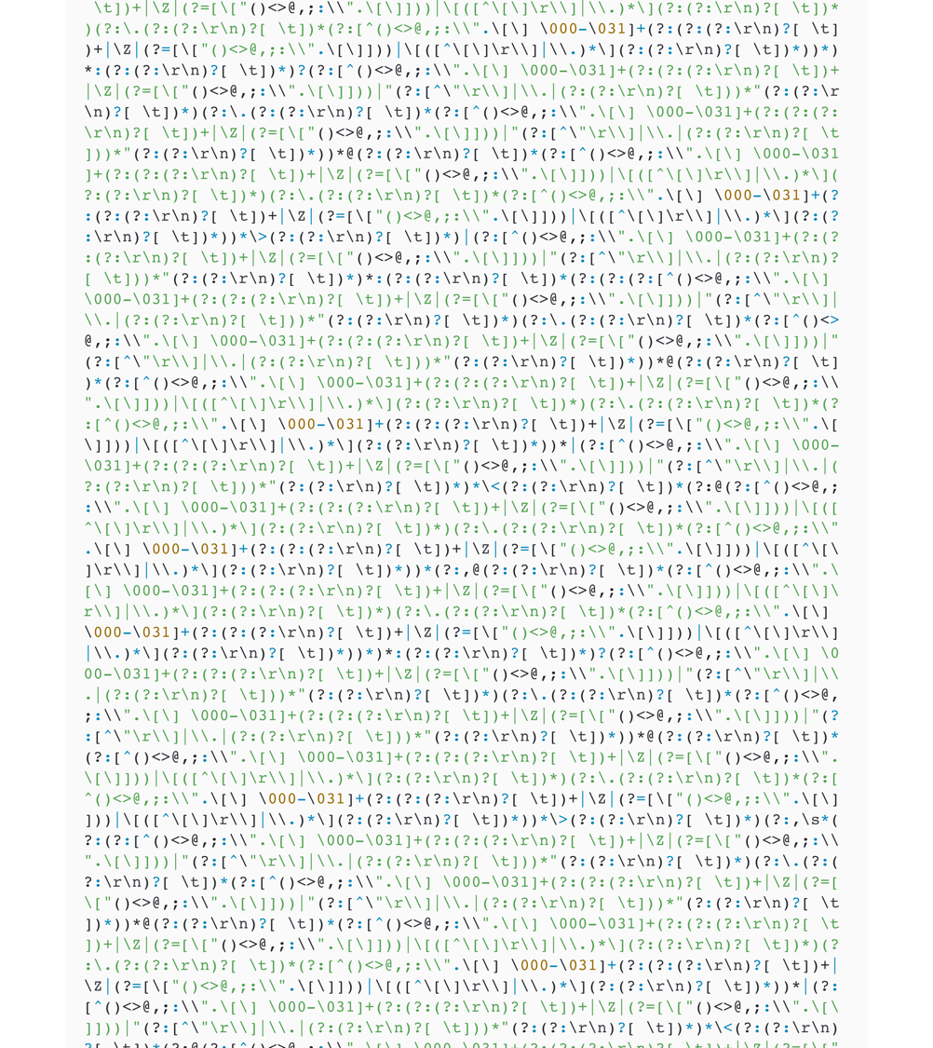
RFC Email Validator
This is too much hot sauce!

Slide 8
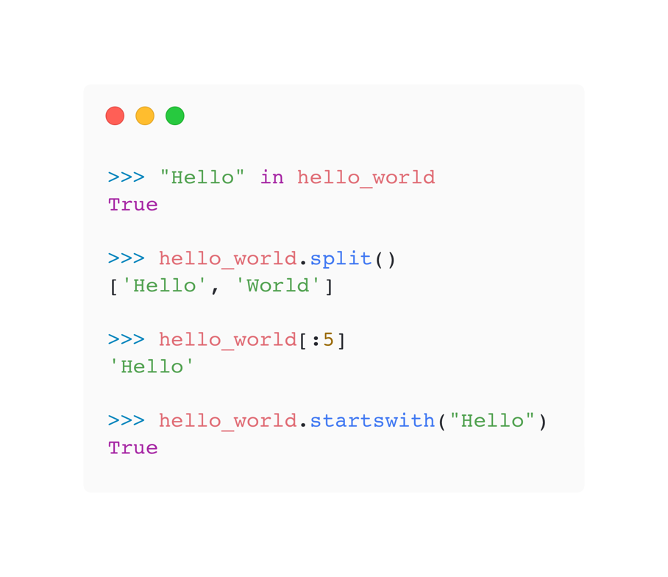
First Utilize Python’s String Manipulation

Slide 9
Not for Parsing
Don’t use a regex for syntax analysis of strings
For HTML parsing, use Beautiful Soup

Slide 10
Main Uses
Something that you will use once and throw away
or
String Validation
String Manipulation
and then only if there aren’t other good options

Slide 11
Common Regex Characters
. | Matches any single character (except newlines, normally)
\ | Escape a special character (\. matches a literal dot)
? | The preceding character may or may not be present (/hell?o/ would match hello or helo)
* | Any number of the preceding character is allowed (e.g. .* will match any single-line string, including an empty string, and gets used a lot)
+ | One or more of the preceding character (.+ is the same as .* except that it won’t match an empty string)
| | “or”, match the preceding section or the following section (hello|mad will match “hello” or “mad”)
() | group a section together. This can be useful for conditionals ((a|b)), multipliers ((hello)+), or to create groups for substitutions (see below)
{} | Specify how many of the preceding character (e.g. a{12} matches 12 “a”s in a row)
[] | Match any character in this set. - defines ranges ([a-z] is any lowercase letter), ^ means “not” (e.g. [^,]+ match any number of non-commas in a row)
^ | Beginning of line
$ | End of line

Slide 12
Character Shortcuts
Character | Legend | Example | Sample Match
\d | One digit from 0 to 9 or one Unicode digit in any script | file_\d\d | file_25
\w | Word Character: ASCII letter, digit, underscore, Unicode letter, or ideogram | \w-\w\w\w | A-b_1
\s | Whitespace Character: space, tab, newline, carriage return, vertical tab, any Unicode separator | a\sb\sc | a b c
\D | One character that is not a digit as defined by \d | \D\D\D | ABC
\W | One character that is not a word character as defined by \w | \W\W\W\W\W | *-+=)
\S | One character that is not a whitespace character as defined by \s | \S\S\S\S | Yoyo
\b | Word boundary | \b

Slide 13
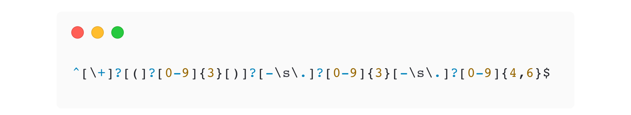
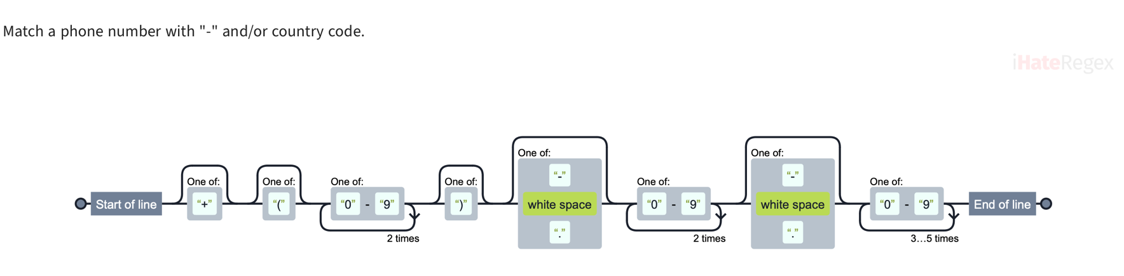
Validator: Match a Phone Number
https://ihateregex.io

Slide 14
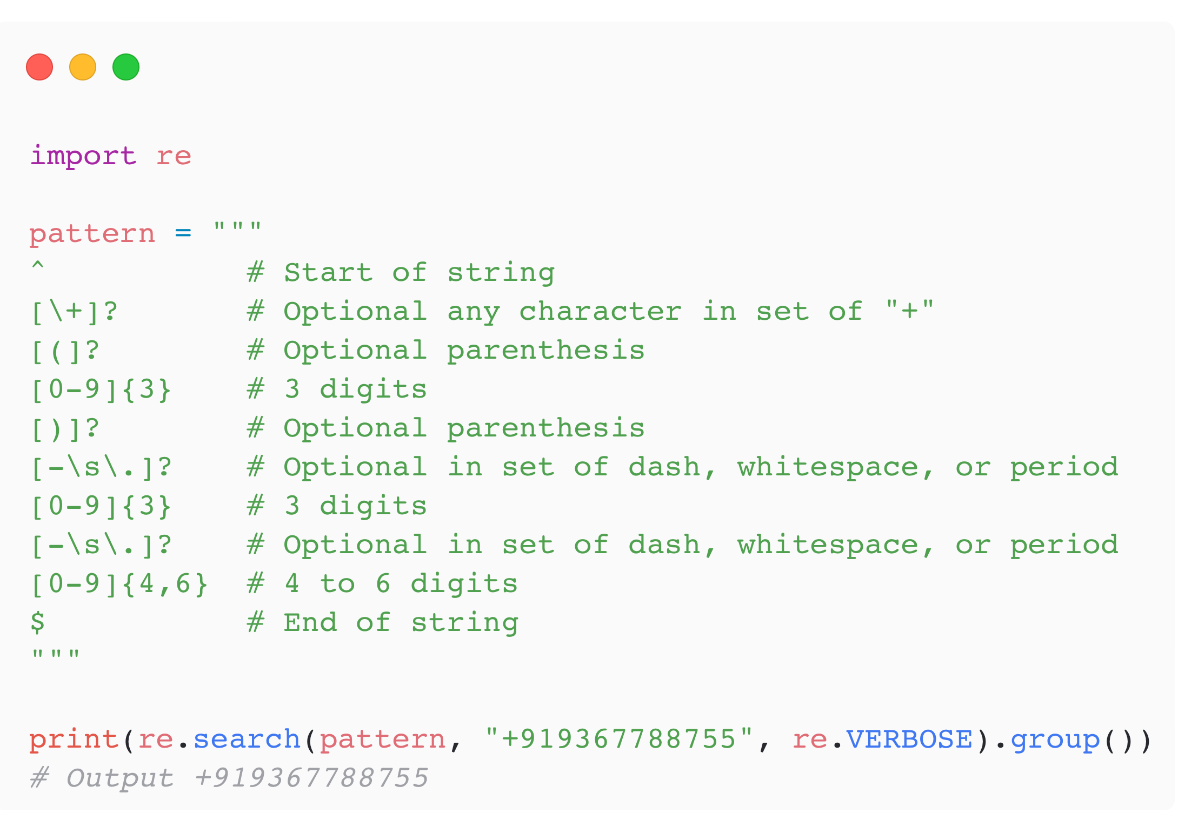
Maintenance Add Comments

Slide 15
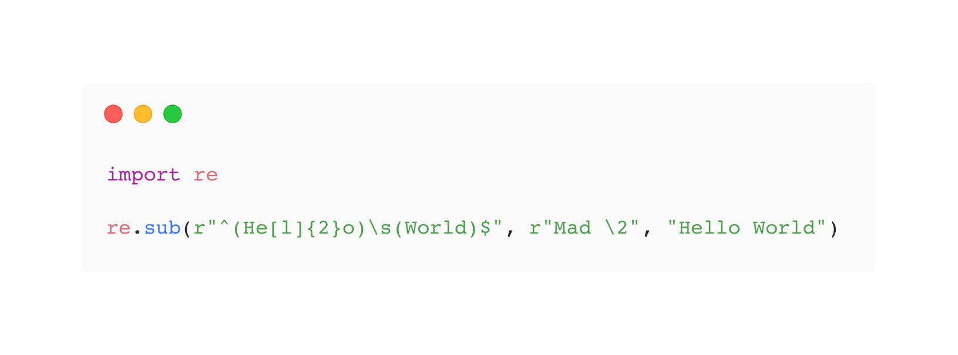
Regex in Substitutions

Slide 16
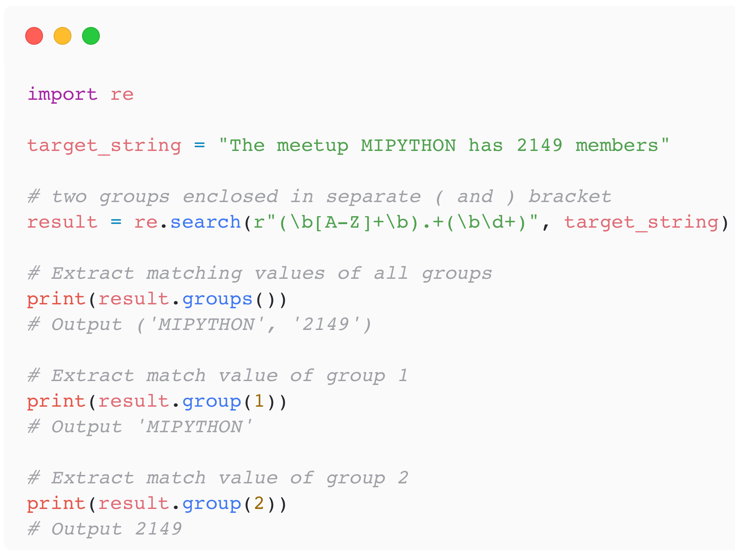
Groups
Groups are defined with ( )

Slide 17
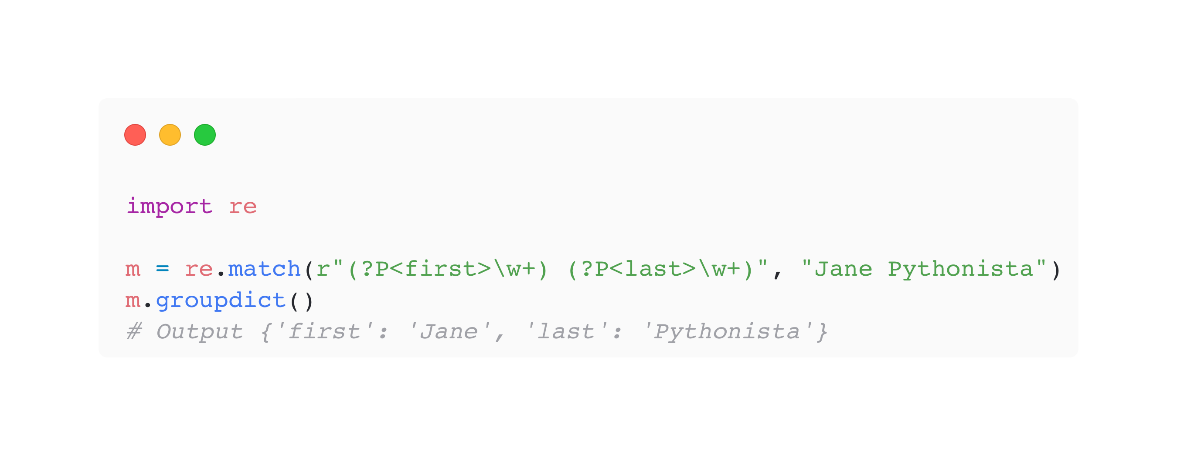
Named Groups
(?P<name> …)

Slide 18
Lazy and Greedy
Greedy Quantifier | Lazy Quantifier | Description
* | *? | Star Quantifier: 0 or more
+ | +? | Plus Quantifier: 1 or more
? | ?? | Optional Quantifier: 0 or 1
{n} | {n}? | Quantifier: exactly n
{n,} | {n,}? | Quantifier: n or more
{n,m} | {n,m}? | Quantifier: between n and m

Slide 19
Lookaround
Lookaround | Name | What it Does
(?=foo) | Lookahead | What immediately follows the current position in the string is foo
(?<=foo) | Lookbehind | What immediately precedes the current position in the string is foo
(?! foo) | Negative Lookahead | What immediately follows the current position in the string is not foo
(?<! foo) | Negative Lookbehind | What immediately precedes the current position in the string is not foo

Slide 20
Validator: Minimum Password Requirement
(?=.*?[A-Z]): At least one upper case English letter
(?=.*?[a-z]): At least one lower case English letter
(?=.*?[0-9]): At least one digit
(?=.*?[#?!@$ %^&*-]): At least one special character or space
.{8,}: Minimum eight in length

Slide 21
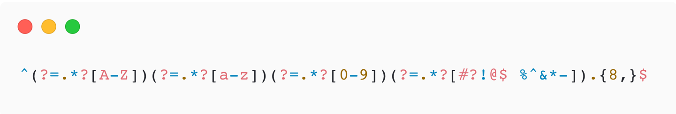
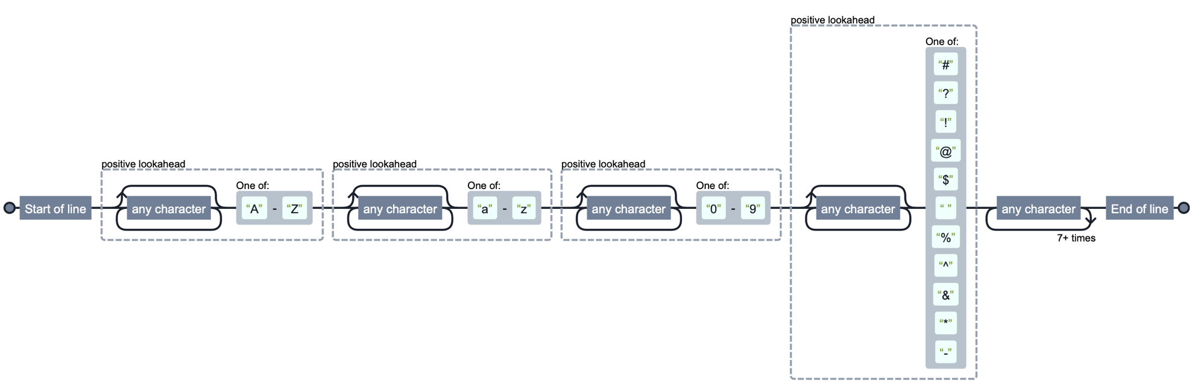
Validator: Minimum Password Requirement
https://ihateregex.io

Slide 22
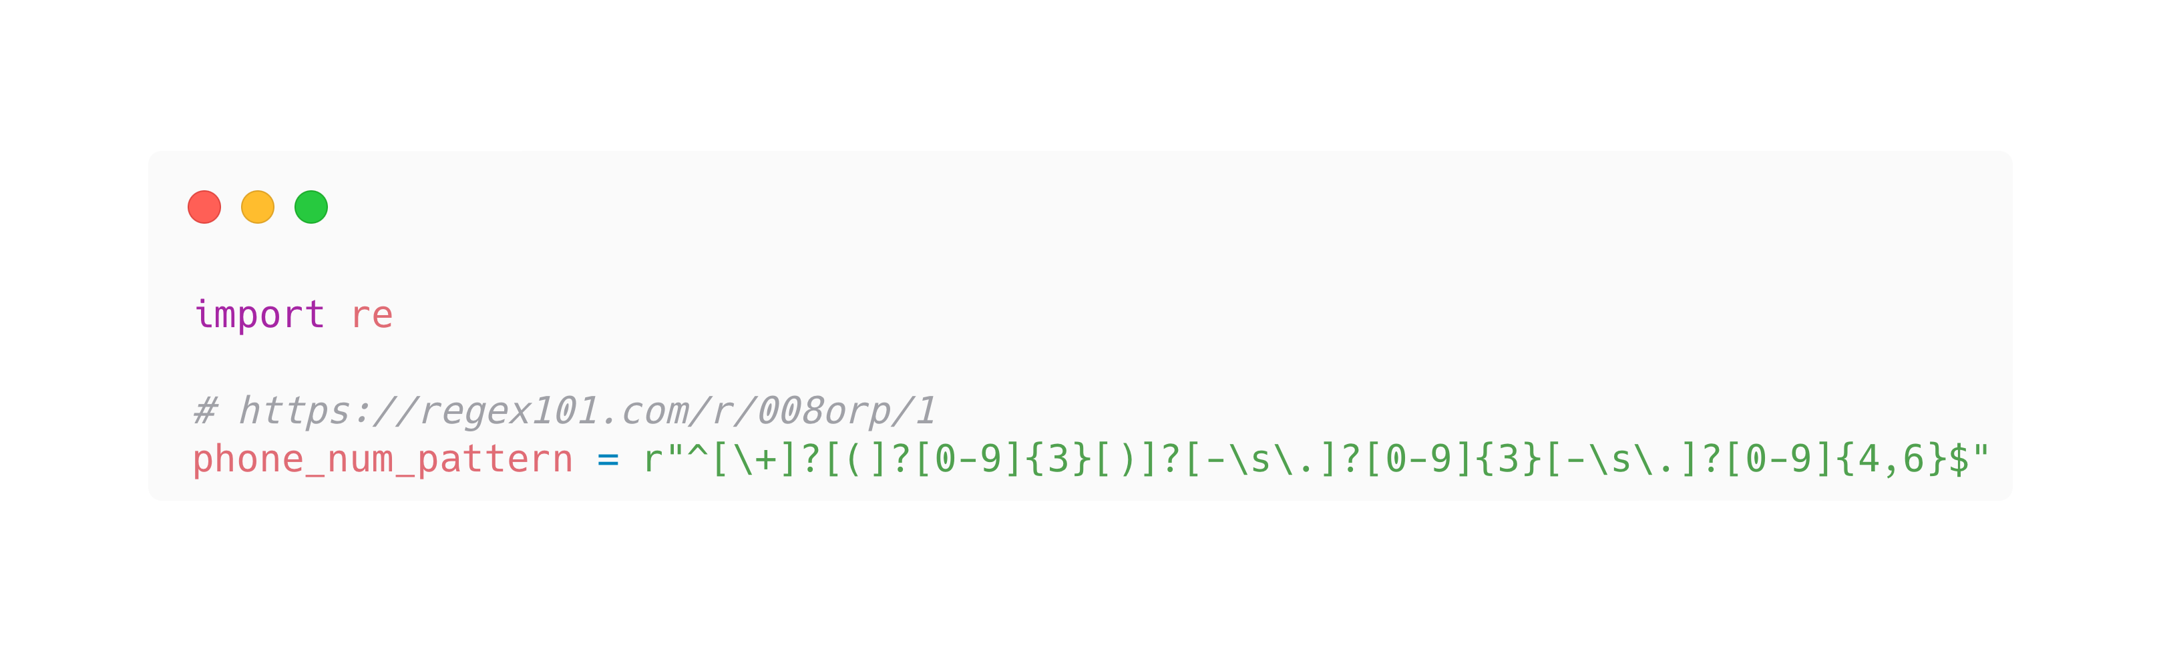
Regex101.com
Iteratively develop your Regex with feedback on match
Save your regex

